Slide 1
Deep Reinforcement Learning
<Hetav Pandya/>

Slide 2
Introduction
{
"Name" : "Hetav Pandya - HP",
“Work" : “Software Engineer",
“Affiliation" : [“Arista Networks”, “UBC AI”],
“Education" : "University of Toronto",
"Experience" : "Intel Corporation, Bell, General Motors"
}

Slide 3
Agenda
{
“ItemsForToday" : [
“Introduction to Deep RL”,
“What are Policy Gradient Methods?”,
“What are DQNs?”,
“Demo with a real-life application”,
“Q&A a.k.a Roasting Session”]
}
Notes:
Opengrok
Version control
Design patterns
Technical documentation
Ownership
Attitude
Know your industry

Slide 4
targetAudience
{
“Audience" : [
“Have a calculus background”,
“Have a probability background”,
“Want to use Deep RL in your work”,
“Are comfortable using Python”,
]
}
Notes:
Opengrok
Version control
Design patterns
Technical documentation
Ownership
Attitude
Know your industry

Slide 5
What is Reinforcement Learning?
“Approach for learning decision making and control from experience”
– CS285 UC Berkeley
Agent
State
Reward
Action
Environment

Slide 6
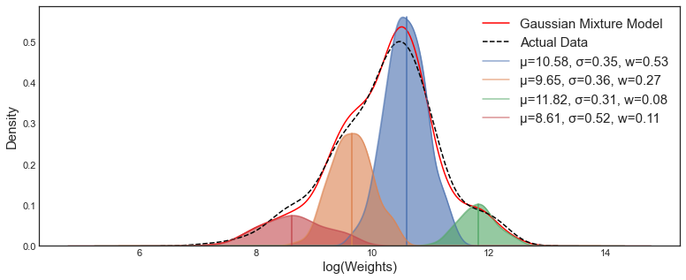
What is DEEP Reinforcement Learning
Historically we used to use approximators like gaussian distributions, linear approximators, sinusoidal regressors…
Now we use ‘Deep’ Neural Networks.
Why?

Slide 7
Where do we use RL?
It is not just games and robots!
For chip design^{[1]}
For improving language models^{[2]}
For inventory management
For image generation ^{[3]}
[1] https://ai.googleblog.com/2020/04/chip-design-with-deep-reinforcement.html
[2] https://huggingface.co/blog/rlhf
[3] Kevin Black*, Michael Janner*, Yilun Du, Ilya Kostrikov, Sergey Levine. Training Diffusion Models with Reinforcement Learning

Slide 8
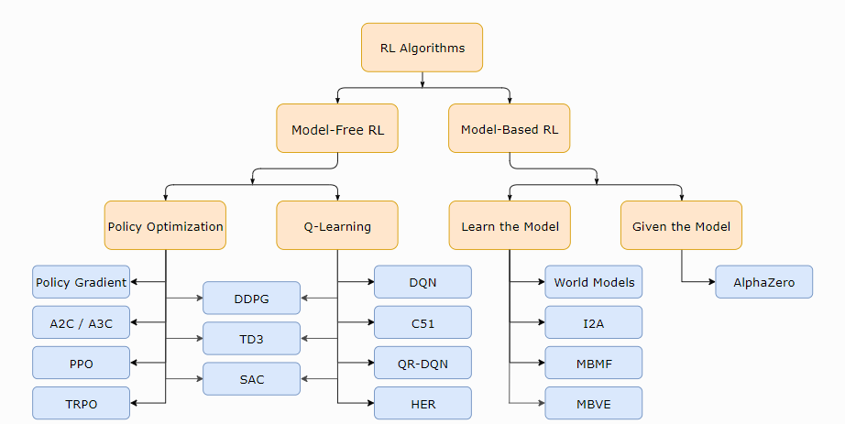
Types of RL Algorithms

Slide 9
The trick to understand any RL algorithm
fit a model/ estimate the return
generate samples (i.e. run the policy)
improve the policy
Source: UC Berkeley CS 285 – Lecture 4 Introduction to Reinforcement Learning

Slide 10

Policy Gradient / REINFORCE Algorithm
$$π_{θ}(a|s)$$
Policy
Parameters
Action
State

Slide 11
The trick to understand any RL algorithm
fit a model/ estimate the return
generate samples (i.e. run the policy)
improve the policy
Source: UC Berkeley CS 285 – Lecture 4 Introduction to Reinforcement Learning

Slide 12

The goal of a policy gradient algorithm
$$J\left(θ\right)=E_{T \sim π_{θ}}\left[\sum_{t=0}^{T}{R(s_{t}, a_{t})}\right]$$
Total reward
Expectation over the current policy
Add all the rewards over T steps
The reward depends on the state and action pair

Slide 13

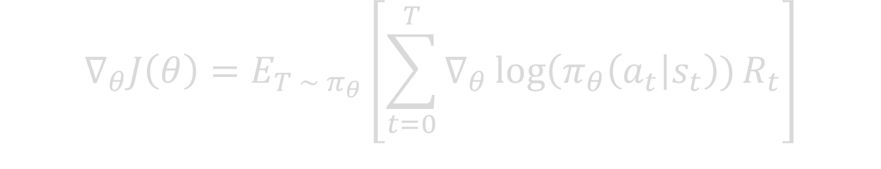
How to improve the policy ‘gradient’ algorithm?
$$∇_{θ}J\left(θ\right)=E_{T \sim π_{θ}}\left[\sum_{t=0}^{T}{∇_{θ}\log\left(π_{θ}\left(a_{t}\right|s_{t}\right))R_{t}}\right]$$
Gradient of total reward
Expectation over the current policy
Summation over T steps
Magic a.k.a complex math

Slide 14

How to improve the policy ‘gradient’ algorithm?
$$θ \text{←} θ \text{+} \text{α}{ ∗∇}_{θ}J\left(θ\right)$$
New parameters of the policy
Old parameters of the policy
Learning rate
Gradient of the ‘reward’ function

Slide 15
The trick to understand any RL algorithm
fit a model/ estimate the return
generate samples (i.e. run the policy)
improve the policy
Source: UC Berkeley CS 285 – Lecture 4 Introduction to Reinforcement Learning

Slide 16
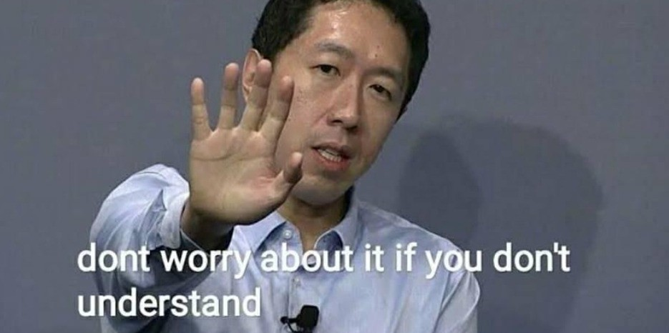
Practical implementation
The math is not necessary ☺
Has prebuilt optimizations
Variance reduction
Leveraging causality theorems
Libraries like PyTorch have AutoGrad support

Slide 17
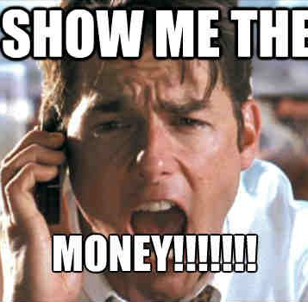
Algorithm -> Business Value
Enhancing recommendation engines to provide more personalized content
Optimizing advertising strategies, such as prices in real-time to maximize conversion rates
Implementing adaptive pricing strategies that adjust prices based on demand
Improving inventory management and logistics by dynamically adjusting order quantities

Slide 18
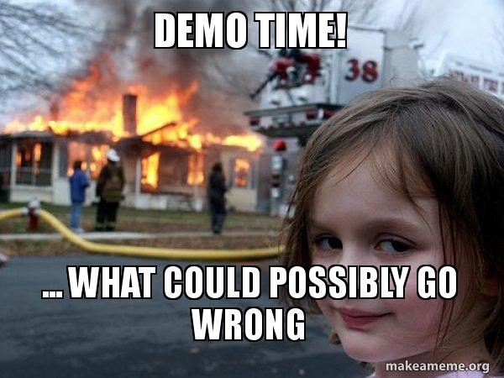
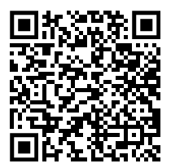
Demo
Making an inventory management system using REINFORCE (policy gradient) algorithm

Slide 19
The Deep Q-Network Algorithm
It uses Deep Neural Networks to learn Q values…
What are Q values?

Slide 20
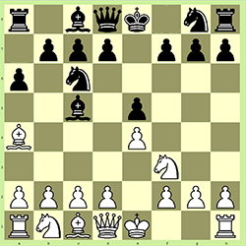

What are Q Values?
What if I move my knight to E5?
$$Q(s, a)$$
The expected total reward I will get…

Slide 21
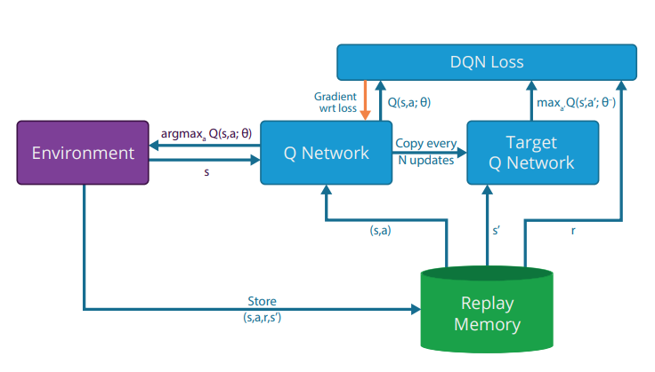
We need to learn a few more terminologies
?
?
?

Slide 22
Let’s talk about replay memory
Mini-batches of observations

Slide 23
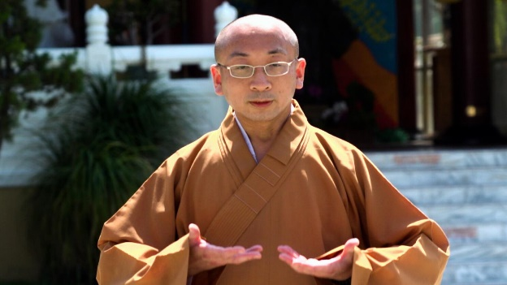

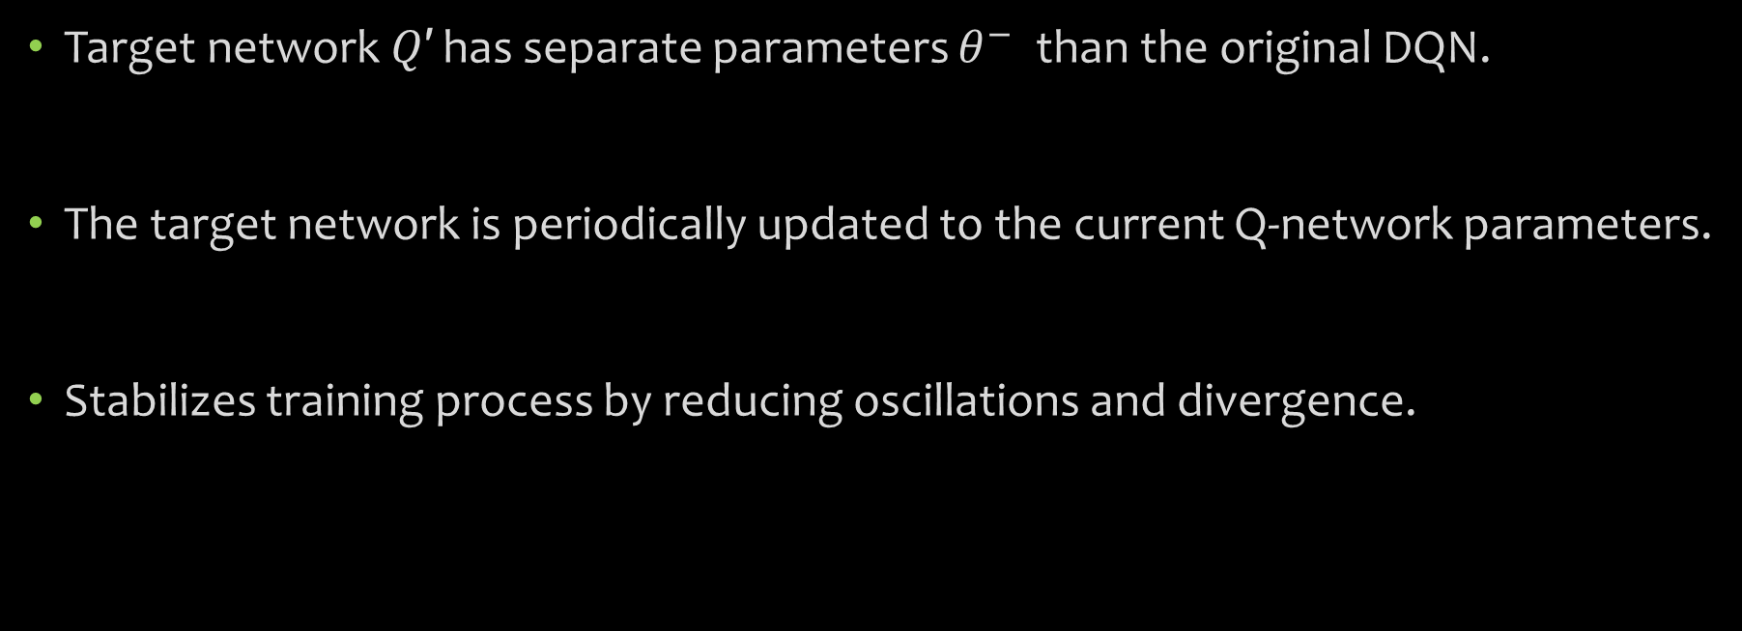
Let’s talk about target network
Target network 𝑄′ has separate parameters $θ^{−}$ than the original DQN.
The target network is periodically updated to the current Q-network parameters.
Stabilizes training process by reducing oscillations and divergence.

Slide 24
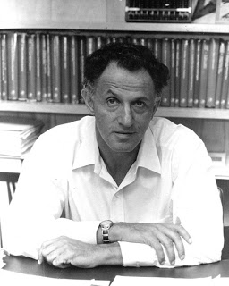
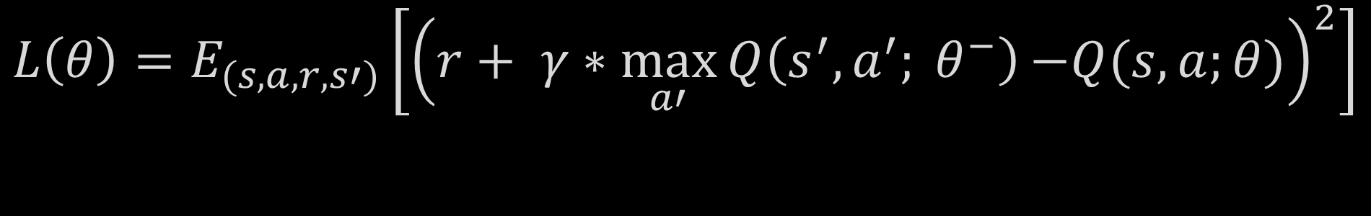
Let’s talk about DQN Loss
$$L\left(θ\right)=E_{(s, a, r, s′)}\left[{\left(r+ γ∗\max_{a′}{Q\left(s^{′}, a^{′}; θ^{−}\right)}{−Q(s, a;θ)}\right)}^{2}\right]$$
The estimate of the future reward based on target Q network
The estimate of the future reward by our DQN
In practice expectations are just an indication that we need to sample data points
Credits:

Slide 25
The trick to understand any RL algorithm
fit a model / estimate the return
generate samples (i.e. run the policy)
improve the policy
Source: UC Berkeley CS 285 – Lecture 4 Introduction to Reinforcement Learning

Slide 26

How to improve DQN Parameters?
$$θ \text{←} θ\text{ −} \text{α}{ ∗∇}_{θ}L\left(θ\right)$$
New parameters of the DQN
Old parameters of the DQN
Learning rate
Gradient of the ‘loss’ function

Slide 27
The trick to understand any RL algorithm
fit a model / estimate the return
generate samples (i.e. run the policy)
improve the policy
Source: UC Berkeley CS 285 – Lecture 4 Introduction to Reinforcement Learning

Slide 28
How it all connects!
?
?
?

Slide 29


Let’s have a break Winner gets a KitKat
DQN Update
Policy Gradient Update
$$θ \text{←} θ\text{ −} \text{α}{ ∗∇}_{θ}L\left(θ\right)$$
$$θ \text{←} θ \text{+} \text{α}{ ∗∇}_{θ}J\left(θ\right)$$
Why the difference?

Slide 30

Algorithm -> Business Value
Design strategy for trading algorithms
Optimize energy consumption in smart grids by learning from usage patterns
Improve logistics and transportation planning by dynamically adjusting routes
Optimize stock levels and reorder points by learning from historical sales data and demand patterns

Slide 31
Demo
Making an inventory management system using DQN.

Slide 32
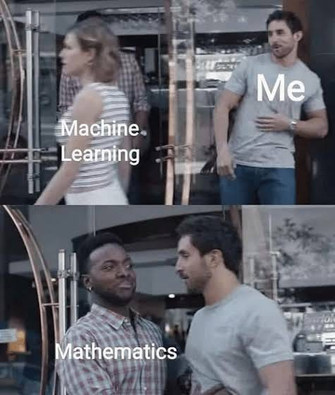
Thank you for being here till the end!
As an engineer it is important to know the ‘how’
As a student of science, it is important to understand the ‘why’

Slide 33

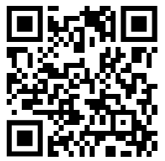


Connect if you wish to...
Talk more about ML, seismology, physics, open-source software
Teach me more about any topic
Say hello, hola, namaste, ni hao
Tag along for hiking, running, dancing ☺
Feedback!

